Slide 1
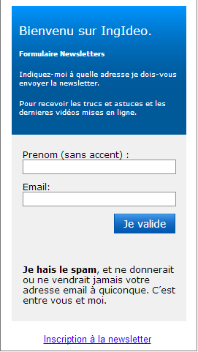
EXEMPLE ANIMATION
POWERPOINT_2013_EFFET_AMPOULE
OUTILS : ” EFFET AMPOULE ”
http://maitrise-excel.com/

Slide 3
NORMAL
UNION
COMBINER
INTERSECTION
SOUSTRACTION
FRAGMENTER

Slide 4
IDEE 1
IDEE 4
IDEE 2
IDEE 3

Slide 5
IDEE 1
IDEE 4
IDEE 2
IDEE 3

Slide 6
IDEE 1
IDEE 3
IDEE 2
IDEE 4

